Slide 1
User Engagement Analysis For
Ajanta Electronics Shop Success
Created by: Manish Sharma

Slide 2
About Ajanta Electronics Shop
Ajanta is an electronics shop which secure it’s presence in
E-market for last 3 Years. It is a leading electronics shop
committed to providing cutting edge technology,
products of top brands at an competitive prices.

Slide 3
AGENDA
Problem Statement
Data Overview
Assumptions
Research Questions
Analysis and Findings
Recommendations

Slide 4
Problem Statement
Ajanta electronics is startup in a competitive markets like electronics market and online market industry, understanding the factors that influence the business success is a crucial for stakeholders. Utilizing the dataset, this project is aims to investigate the relationship between user engagement and business success metrics for ajanta electronics shop.

Slide 5
Data Overview
There are 12 files of data in csv format.
The data we have used is of the year 2019 and also have a very few rows of the year 2020 (negligible amount), so we have removed it
All the files have been concatenated together to make useful insights.

Slide 6
Assumptions
The information is still current and can be used to analyze a shop possible planes in an efficient manner.
No unusual occurrence in 2019, will have substantial on the data used.
The shop is not currently using any of the suggested solution.

Slide 7
Research Questions
What was the month with best sales? how much was earned that month?
Which city had the highest number of sales?
What time should we display ads to maximize likelihood of customers buying products?
Which products are most often sold?
Does price of each product affect the No. of Ordered Quantity?

Slide 8
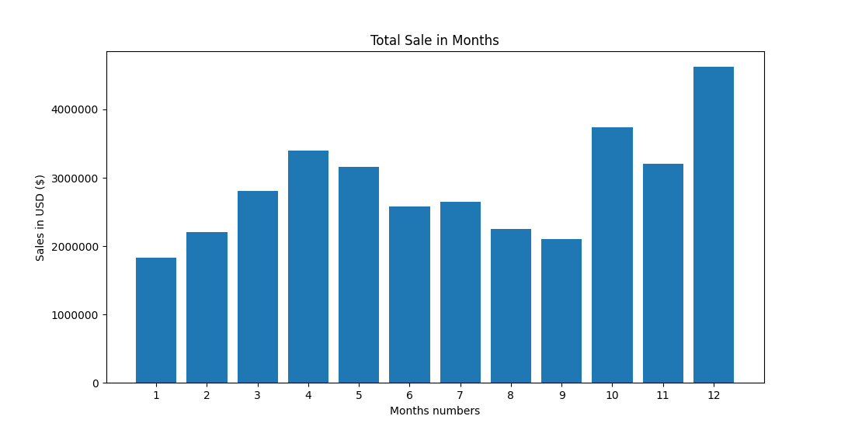
What was the month with best sales? how much was earned that month?
Analysis And Insights
This bar graph shows the relation between Months on X-axis and Sales on Y-axis.
We can clearly see that the sales is maximum in December month with an amount of 4613443.34 dollars and minimum in january month with an amount of 1822256.73 dollars.
We can also notice the trends in sales that sales has increased till April (in autumn season) than decrease till September (in rainy season) than again increase till December (in starting of winter season).

Slide 9
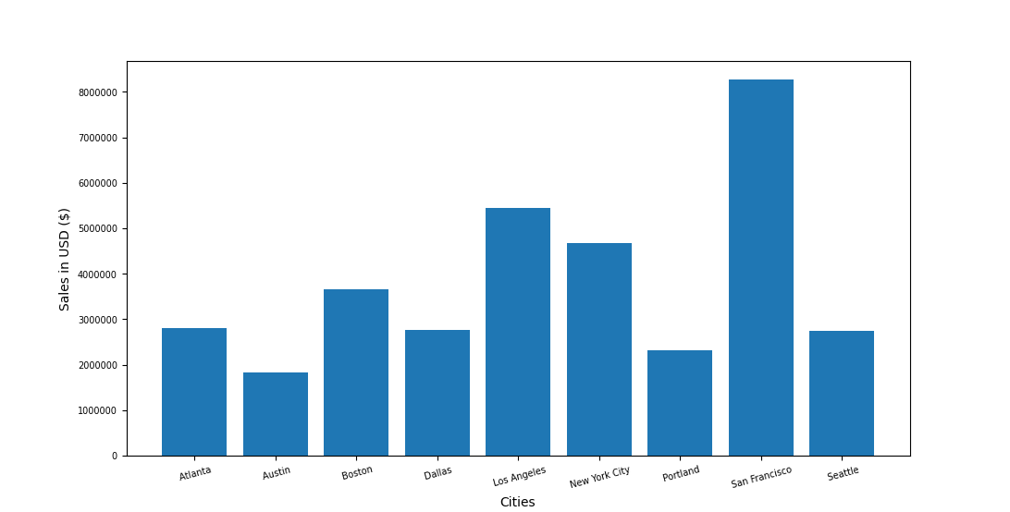
Which city had the highest number of sales?
This bar graph shows the relation between Cities on X-axis and Sales on Y-axis.
Among all the cities San Francisco has the highest sale that is 8262203.91 dollars and Austin has the minimum sale that is 1819581.75 dollars.
It seems that San Francisco has that over high sales may be due to maximum number of ordered quantity of products or may be due to expensive products with moderate ordered quantity, lets figure out on next slide.

Slide 10

This bar graph shows the relation between Cities and Sales over Number of Quantity Ordered represented by line chart.
As we saw San Francisco has the highest sale, but in it we can clearly see that the number of ordered quantity is also maximum and has same height as that of sales, this indicates that the people may ordered budget products more than expensive products.
But in Austin, sales is higher than the number of ordered products this may possible because people may order expensive products more than the budget products.
Cities like Boston, Dallas, Los Angeles, New York City may have ordered more budget and mid range products and less expensive products and cities like Atlanta, Portland and Seattle also may have ordered expensive and mid range products products more than the budget.

Slide 11
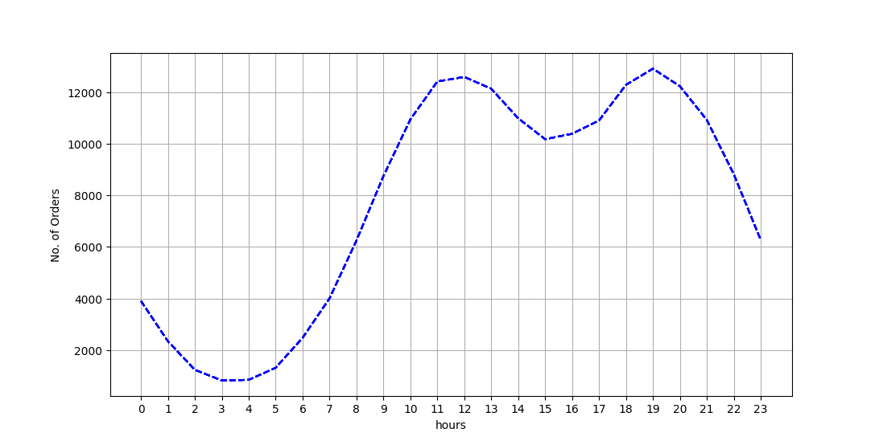
What time should we display ads to maximize likelihood of customers buying products?
Digital Marketing is the key factor for enhancing the customers and also for increasing the sales in a business by running ads on various platforms.
This line graph represents Number of orders placed at what time (in hours) having time ( in hours) on X-axis and Number of Orders on Y-axis.
Maximum orders (around 9K and above) are placed in day time from 9 AM (in morning) to 10 PM (in night).
Most of the order (around 12K and above) are placed in afternoon ( between 11AM to 1PM) and in evening (between 6PM to 8PM).
Minimum orders are placed in night (even less than 2K).

Slide 12
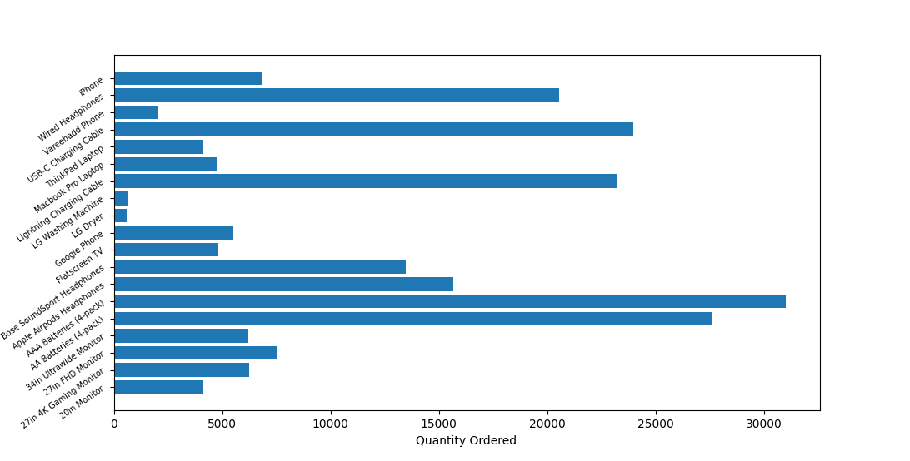
Which products are most often sold ?
This graph represents which products are sold the most having quantity of ordered products on X-axis and name of products on Y-axis.
As we see AAA Batteries and AA Batteries are the most ordered product with 31017 and 27635 units holding the 1st and 2nd position respectively.
USB –C Charging Cable with 23975 units, Lightning Charging Cable with 23217 units and Wired Headphones with 20557 units are in top 5 products that are most often sold.

Slide 13
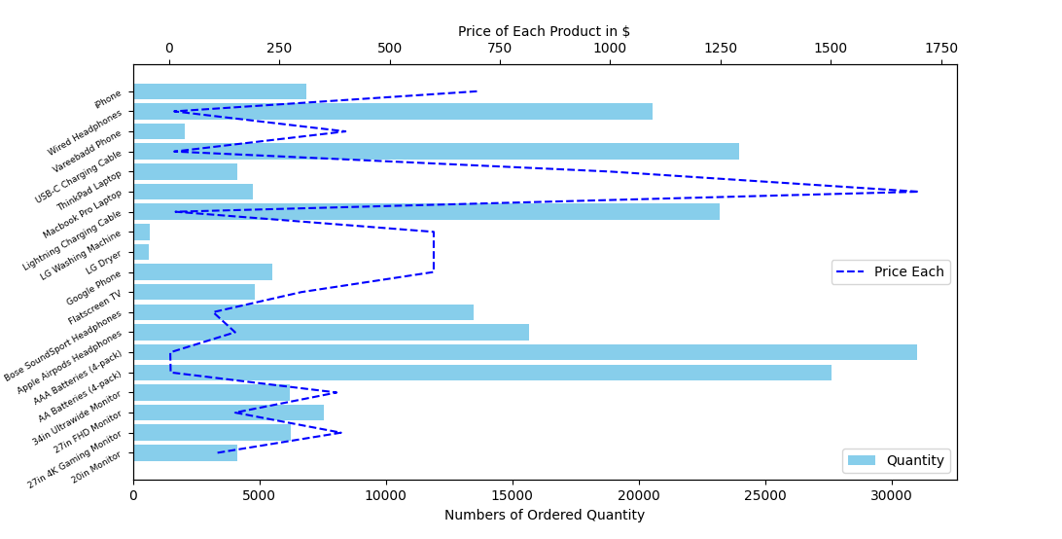
Does price of each product affect the No. of Ordered Quantity?
This graph shows the relation between products, Number of Quantity Ordered over price of each product represented by line chart.
Ordered Quantity o f products and Price of each product are inverse to each other.
As maximum products ordered by the people are those which have minimum price or budget range price, like AAA Batteries and AA Batteries have minimum price ($2.99 and $ 3.84 each) so people ordered these items the most.
Products like LG Dryer, LG Washing Machine are the minimum ordered product at price of $600 each because may be this deal is not value for money for the buyers as because Thinkpad laptop and Macbook Pro are the highest price but have 4728 units ordered by people.
But overall quantity of budget products ordered the most and expensive products ordered the least by the customers.

Slide 14
Recommendations
There is slightly up-down trends of sales in months which may be due to seasonal or festivals, less sales months may need to focus on strategies to enhance user engagement over time, such as giving additional discounts on expensive products or by start any campaigns to attract new customers etc.
Cities with high sales presents opportunity for business to expend no. of customers by displaying ads and start promotional campaigns to attract new users, but cities with low sales need to focus on brand awareness, start promotional ads of discounts on expensive products etc
Promotional ads can be run on during high peeks hours of customers buying products for campaigns and sales to increase demands.
Products with high price was not bought by the customers may be because that products are not having value for money for customers, so decrease the rates of products by giving discounts.

